Slide 1
Data Structure Algorithm
Section 13 - hashing

Slide 2
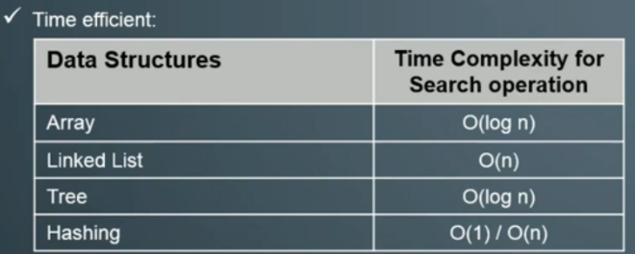
Why we need Hashing?

Slide 3
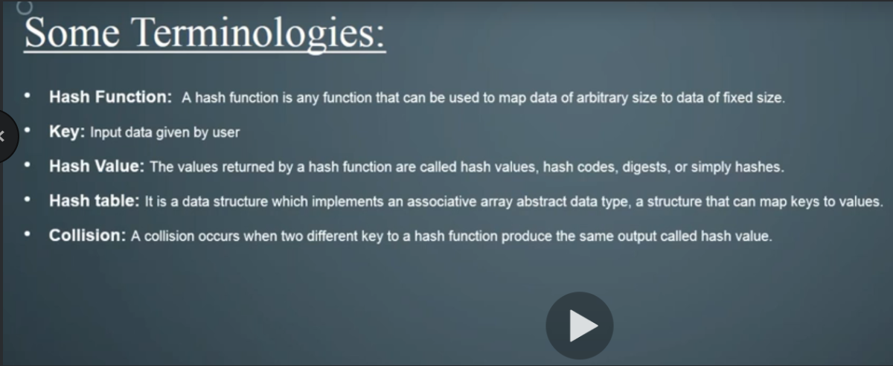
Some Terminologies

Slide 4
Characteristics of good Hash Function
It distributes hash values uniformly across the hash table.
The hash function uses all the input data.

Slide 5
Characteristics of good Hash Function
It distributes hash values uniformly across the hash table.
The hash function uses all the input data.

Slide 6
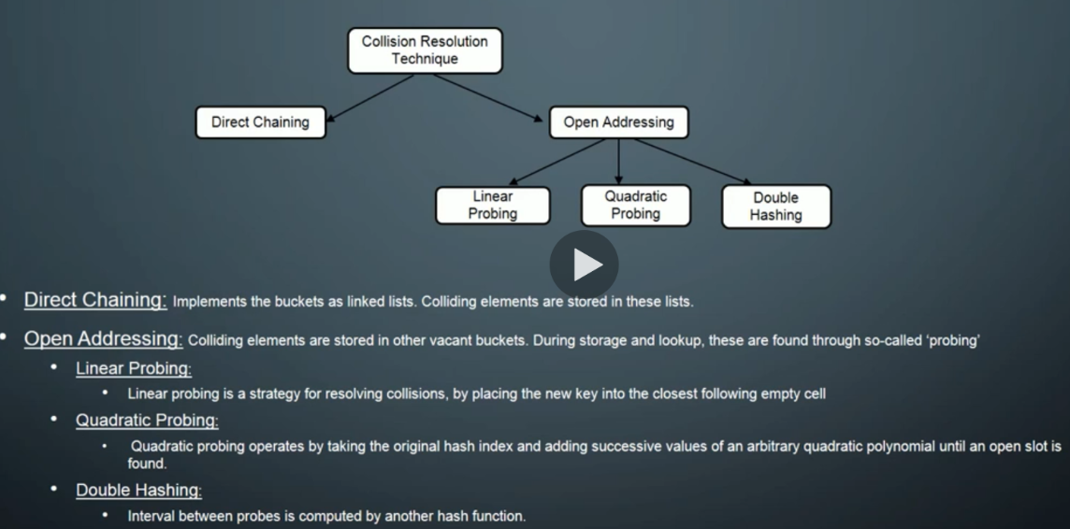
Collision Resolution Techniques

Slide 7
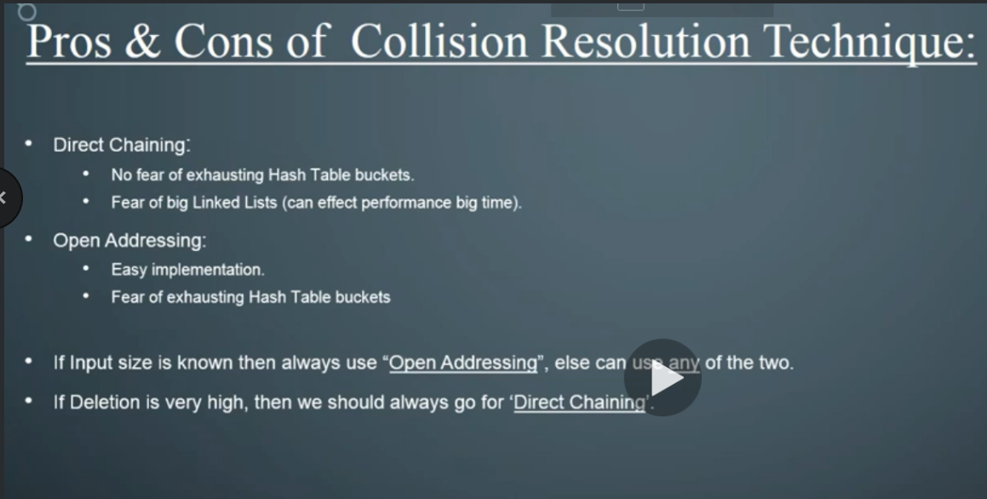
Pros & Cons of Collision Resolution Technique

Slide 8
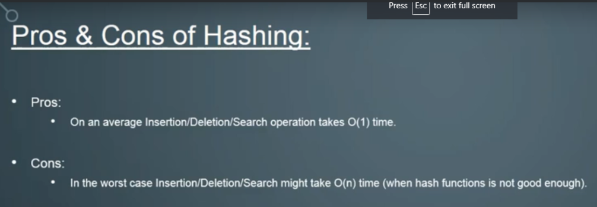
Pros & Cons of Hashing

Slide 9
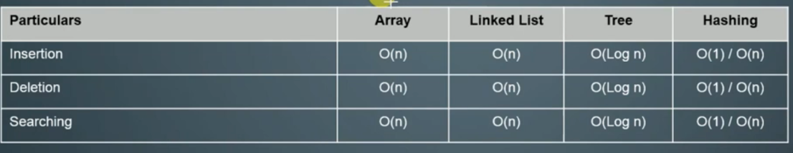
Hashing vs other DS

Slide 10
Data Structure Algorithm
Section 14 - Sorting

Slide 11
What will we learn in this Topic?
- What is sorting
- Types of Sorting
- Sorting Terminologies
- Why learn so many sorting techniques?
- Sorting Algorithms
- Bubble
- Selection
- Insertion
- Bucket
- Merge
- Quick
- Heap
- Comparison of all types of sorting techniques

Slide 12
What is Sorting?
Definition: Sorting refers to arranging data in particular format: either ascending or descending.
Practical uses of Sorting:
Microsoft excel - Has an inbuilt functionality to sort data.
Online Stores - one stores generally have option of sorting search result by Price, Review, Ratings, etc.

Slide 13
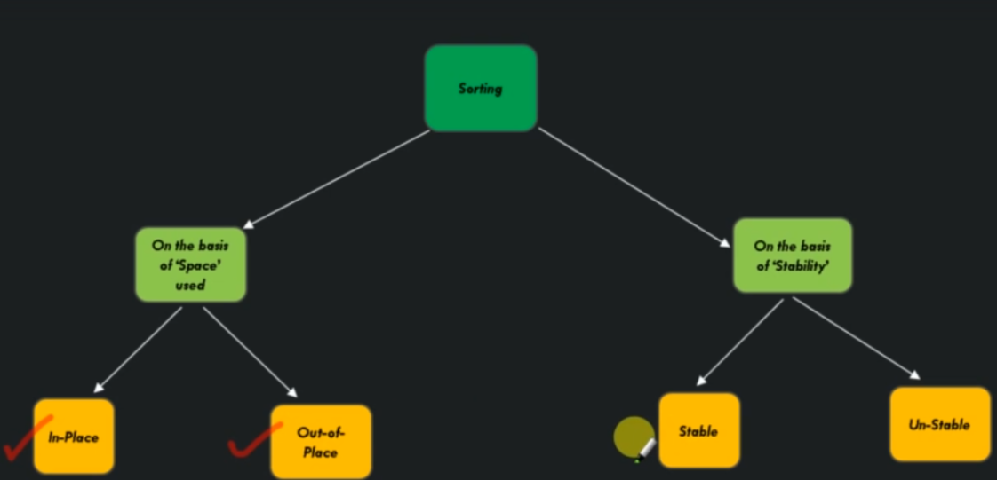
Types of Sorting

Slide 14
In-Place vs Out-Place Sorting
- In-Place Sort
Sorting algorithms which does not require any extra space for sorting.
Example - Bubble sort
Out-Place Sort
Sorting algorithms which requires extra space for sorting.
Example - Merge sort

Slide 15
Stable vs Unstable Sorting
Stable Sort
If a Sorting algorithm after sorting the content does not change the sequence of similar content in which the appear, is called Stable sorting.
Example - Insertion sort
Unstable Sort
If a sorting algorithm after sorting the content, changes the sequence of similar content in which they appear, it is called unstable sort.
Example - Quick Sort

Slide 16
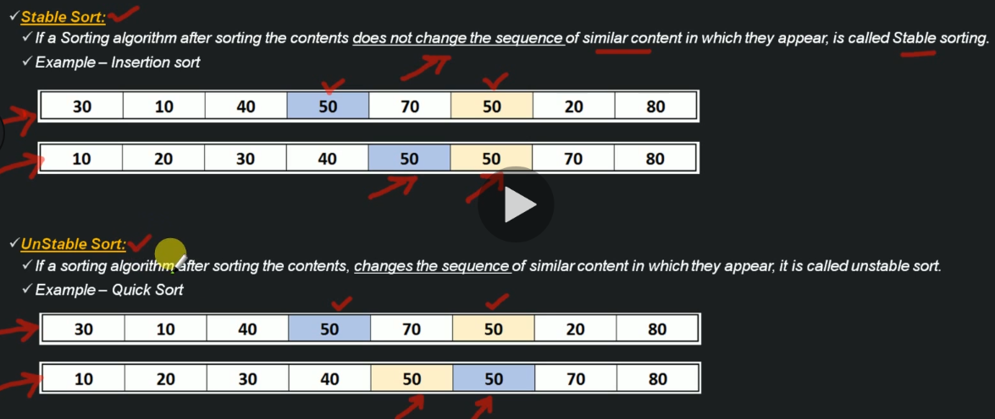
Stable vs Unstable Sorting

Slide 17
Why 'Stable Sort' is important?
Scenarios where 'sort key' is not the entire identity of the item.
Consider a person object with a name and a Age. Lets say we sorted based on their name. If we were to then sort by age in a stable way, we'd guarantee that our original ordering would be preserved for people with the same age.
Note: Group by from SQL is an example of Stable Sort

Slide 18
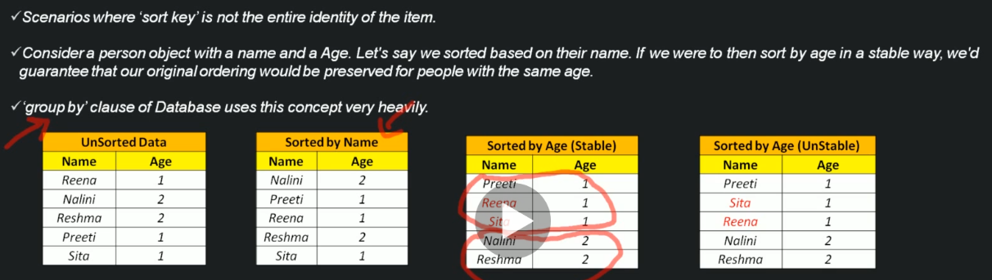
Why 'Stable Sort' is important?

Slide 19
Few Terminologies
Increasing Order:
If successive element is greater than the previous one.
Example: 1, 3, 4, 6, 8, 9.
Decreasing Order:
If successive element is less than the current one.
Example: 9, 8, 6, 4, 3, 1.

Slide 20
Few Terminologies
Non-Increasing Order :
If successive element is less than or equal to its previous element in the sequence.
Example: 9, 8, 6, 3, 3, 1.
Non-Decreasing Order:
If the successive element is greater than or equal to its previous element in the sequence. This order occurs when the sequence contains duplicate values.
Examples: 1, 3, 3, 6, 8, 9.

Slide 21
Sorting algorithm
Bubble Sort
Selection Sort
Insertion Sort
Bucket Sort
Merge Sort
Quick Sort
Heap Sort
Topological Sort

Slide 22
Why should we read so many Sorting Techniques?
Every Sorting Techniques comes with its set of Pros and Cons. So we need to use specific sorting Techniques as per the situation.
Do we have special requirement of 'Stability'?
Is 'Space' Priority to us?
Is 'Time' Priority to us?

Slide 23
What is Bubble Sort:
Bubble sort, sometimes is also referred as Sinking sort.
Repeatedly steps through the list to be sorted, compares each pair of adjacent
Items and swaps them if they are in the wrong order.

Slide 24
What is Bubble Sort:
bubbleSort(int arr[])
int n = arr.length;
for ( int i = 0, i < n - 1; i++ ) //run from first cell to last cell
for ( int j = 0; j < n - i - 1; j++ ) //run from first cell to "last cell - iteration"
if ( arr[j] > arr [j + 1] ){
swap( arr[j], arr[j+1] )
}

Slide 25
Selection Sort
The Selection sort algorithm is based on the idea of finding the minimum or maximum element in an unsorted array and then putting it in its correct position in a sorted array.
SelectionSort(A):
loop: j = 0 to n-1
int iMin = j;
loop: i = j+1 to n-1
if (a[i] < a[iMin])
iMin=i
if (iMin != j)
swap(a[j], a[iMin]);

Slide 26
Selection Sort
SelectionSort(A):
loop: j = 0 to n-1 ------------------------------------- O(n) _ _
int iMin = j; -------------------- O(1) ---| |
loop: i = j+1 to n-1 ------------- O(n) | |
if (a[i] < a[iMin]) ------------ O(1) |---------- O(n) |---- O(n^2)
iMin=i ----------------------- O(1) | |
if (iMin != j) ----------------- O(1) ---| _ _|
swap(a[j], a[iMin]); --------- O(1)
Time Complexity - O(n^2)
Space Complexity - O(1)

Slide 27
Selection Sort
When to Use/Avoid Selection
- When to use:
- When we don't have additional memory
- Want easy implementation
When not to use:
- When time complexity is a concern

Slide 28
Insertion Sort:
In Insertion sort algorithm we divide the given array into 2 parts. i.e.
Sorted & Unsorted.
Then from Unsorted we pick the first element and find its correct position in sorted array.
InsertionSort(A):
loop: i = 1 to n
currentNumber = A[i], j=1
while(A[j-1] > currentNumber && j > 0)
A[j] = A[j-1]
j --
A[j] = currentNumber

Slide 29
Insertion Sort:
InsertionSort(A):
loop: i = 1 to n ----------------------------------------------------------------------- O(n) ---
currentNumber = A[i], j=1 ------------------------------------- O(1) __ |
while(A[j-1] > currentNumber && j > 0) ------------------ O(n) | |
A[j] = A[j-1] ------------------------------------------------------- O(1) |--- O(n) | --- O(n^2)
j -- -------------------------------------------------------------------- O(1) | |
A[j] = currentNumber ----------------------------------------- O(1) __| __|
Time Complexity - O(n^2)
Space Complexity - O(1)

Slide 30
When to Use/Avoid insertion Sort:
When to use:
- No extra space
- Simple implementation
- Best when we have continuous inflow of numbers and we want to keep the list shorted.
When not to use:
- Average case is bad. (algorithm take much time to be executed. O(n^2))

Slide 31
Bucket Sort:
Bucket sort is a sorting algorithm that works by distributing the elements of an array into a number of buckets.
Each bucket is then sorted individually.

Slide 32
Bucket Sort Algorithm
1) Create Number of buckets = ceil/floor (squareroot of total number of items)
2) Iterate through each number and place it in appropriate bucket.
3) Appropriate bucket = Ceil((Value*number of buckets) / max value in array)
4) Sort all the buckets
5) Merge all the buckets

Slide 33
Bucket Sort Algorithm
BucketSort(A):
find no. of buckets to be created and created those buckets B1[], B2[]...
find divisor value
loop: i = 0 to n-1
insert A[i] into array B[] using divisor and bucket#
sort B[] with insertion sort (or any sort as per comfort)
concatenate B1[], B2[], B3[]...

Slide 34
Bucket Sort Algorithm
Time & Space Complexity of Bucket Sort Algorithm
BucketSort(A):
find no. of buckets to be created and created those buckets B1[], B2[]... ----------- O(1)
find divisor value ----------------------------------------------------------------- O(1)
loop: i = 0 to n-1 ----------------------------------------------------------------- O(n)
insert A[i] into array B[] using divisor and bucket# ------------------------------ O(1)
sort B[] ---------------------------------------------------------------------------- O(n logn)
concatenate B1[], B2[], B3[]... ----------------------------------------------------- O(n)
Time Complexity = O(n) + O(n log n) + O(n)
= O(n logn)
Space Complexity - O(n)

Slide 35
Bucket Sort Algorithm
When to Use/Avoid Bucket Sort
- When to use:
- When input is uniformaly distributed over a range. (ex uniformaly 10 - 100) (ex not uniformaly 1,3,5,91,96)
- When not to use:
- When space is a concern.

Slide 36
Merge Sort
Merge Sort is a Divide and Conquer algorithm.
It divides input array in two halves, keeps breaking those 2 halves recursively until they become too small to be broken further.
Then each of the broken pieces are merged together to inch towards final answer.

Slide 37
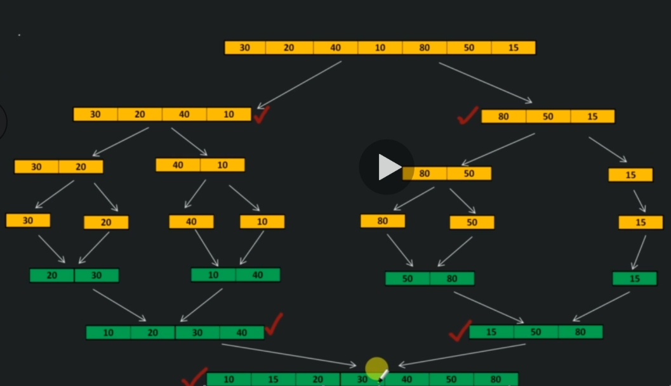
How to Merge Sort works?

Slide 38
Merge Sort algorithm
mergeSort(A,I,r):
if r > I
middle m = (I+r)/2
mergeSort(A,I,m)
mergeSort(A,m+1,r)
merge(A,I,m,r)

Slide 39
Merge Sort algorithm
merge(A,p,m,r)
create tpm arrays L & R and copy A,p,m into L & A,m+1,r into R
i = j = 0;
loop: k = p to r
if L[i] < R[j]
A[k] = L[i]; i++
else
a[k] = R[j]; j++

Slide 40
Merge Sort algorithm
Time & Space complexity of Merge Sort Algorithm
mergeSort(A,I,r): ------------------- T(n)
if r > I --------------------------- O(1)
middle m = (I+r)/2 ---------------- O(1)
mergeSort(A,I,m) ------------------ T(n/2)
mergeSort(A,m+1,r) ---------------- T(n/2)
merge(A,I,m,r) -------------------- O(n)

Slide 41
Quick Sort Algorithm
Quick Sort is a Divide and Conquer algorithm.
At each step it finds 'Pivot' and then makes sure that all smaller element are left of 'Pivot' and all bigger elements are 'Right' of 'Pivot'.
It does this recursively until the entire array is sorted.
Unlike Mere Sort it does not require any external space.

Slide 42
Quick Sort Algorithm
QuickSort(A,p,q)
if(p<q)
r = partition(A,p,q)
QuickSort(A,p,r-1)
QucikSort(A,r+1,p)
---------------------------------------------------------------------
Partition(A,p,q)
pivot = q
i=p-1
for(j=p to q)
if(A[i] <= A[pivot])
increment i and then swap(A[i],[j])

Slide 43
Quick Sort Algorithm
Time & Space complexity of Quick Sort Algorithm
QuickSort(A,p,q) --------------------------------------------------- T(n)
if(p<q) ------------------------------------------------------------- O(1)
r = partition(A,p,q) -------------------------------------------- O(n)
QuickSort(A,p,r-1) --------------------------------------------- T(n/2)
QucikSort(A,r+1,p) --------------------------------------------- T(n/2)

Slide 44
Quick Sort Algorithm
Time & Space complexity of Quick Sort Algorithm
Partition(A,p,q)
pivot = q -------------------------------------------------------- O(1)
i=p-1 ------------------------------------------------------------ O(1)
for(j=p to q) ---------------------------------------- O(n)---------
if(A[i] <= A[pivot]) ------------------------------- O(1) | --- O(n)
increment i and then swap(A[i],[j]) --------- O(1)----
Time Complexity - O(n log n)
Space Complexity - O(n)

Slide 45
Quick Sort Algorithm
When to Use/Avoid Quick Sort:
- When to use:
- When average case is desired to be O(n log n)
- When not to use
- Space is a concern
- When stable sort is required.
Practical uses of Quick Sort:
C#, Java 7, Android

Slide 46
Heap Sort Algorithm
Heap Sort works by first organizing the data to be sorted into a special type of binary tree called a heap.
It then removes the topmost item (the largest/smallest) and inserts it in current Array. It keeps doing until Binary Heap is not empty.
Is best suited with Array. Does not works best with Linked List.

Slide 47
What is Binary Heap:
Definition: Binary Heap is a Binary Tree with some special properties.
Heap property -
Value of any given node must be <= value of its children (Min-Heap)
Value of any given node must be >= value of its children (Max-Heap)

Slide 48
Algorithm - Heap Sort
HeapSort(A)
for i=0 to A.length-1
insertInHeap(A[i])
for i=0 to A.length-1
extractFromHeap(A[i])

Slide 49
Algorithm - Heap Sort
Time & Space Complexity - Heap Sort:
HeapSort(A)
for i=0 to A.length-1 ---------------- O(n)--------------|___ O(n logn)
insertInHeap(A[i]) ----------------- O(log n) --------|
for i=0 to A.length-1 ---------------- O(n) --------------|___ O(n logn)
extractFromHeap(A[i]) ---------- O(log n) ---------|
Time Complexity - O(n logn)
Space Complexity - O(1)

Slide 50
Algorithm - Heap Sort
When to Use/Avoid Heap Sort:
When to Use:
- When space is a concern.
- Better than another sorts like: Bubble Sort, Insertion Sort because is O(n logn)
When not to use:
- When we need our sort to be stable.

Slide 51
Sorting Algorithms Compared
Particulars | Time Complexity | Space Complexity | Stable |
Bubble Sort | O(n^2) | O(1) | Yes |
Selection Sort | O(n^2) | O(1) | No |
Insertion Sort | O(n^2) | O(1) | Yes |
Bucket Sort | O(n logn) | O(n) | Yes |
Merge Sort | O(n logn) | O(n) | Yes |
Quick Sort | O(n logn) | O(n)* | No |
Heap Sort | O(n logn) | O(1) | No |

